Slide 1
Airline Ticket Case Study Data Science
Placeholder confidentiality disclosure.

Slide 2
Presentation:
Data visualization basics
Visualization to gain knowledge about
Artificial Intelligent vs Machine Learning vs Deep Learning
Deep Learning basics
How to build Deep Learning models
Code-along:
Build your own Neural Network to predict Airline Fare

Slide 3
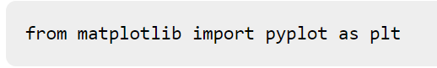
Matplotlib
Python library used to create 2D graphs and plots by using Python scripts
Consists of a module pyplot which supports a very wide variety of graphs and plots - histogram, bar charts, power spectra, error charts etc.
Also provides features to control line styles, font properties, formatting axes etc., making things easier for plotting
Importing the package into Python script:

Slide 4
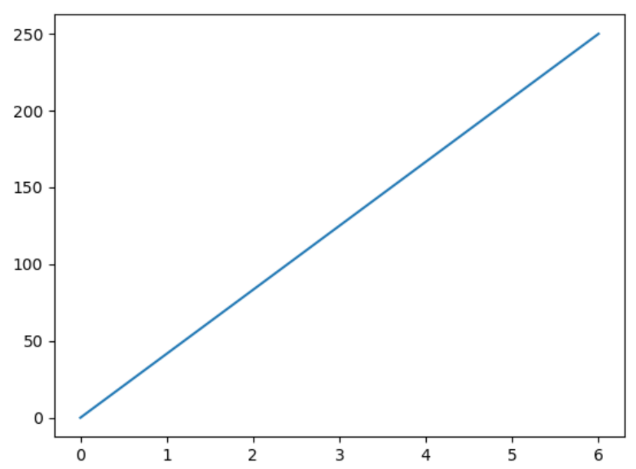
Example:
Line graph from position (0,0) to (6,250)
Code:
import matplotlib.pyplot as plt import numpy as np xpoints = np.array([0, 6]) ypoints = np.array([0, 250]) plt.plot(xpoints, ypoints) plt.show()
Output:

Slide 5
Seaborn
Seaborn is an open-source Python library built on top of Matplotlib.
Provides many color palettes and default beautiful styles to make statistical plots in Python more attractive.
Plot: Plots are generally used to make visualization of the relationships between the given variables. These variables can either be a categorical or can be completely numerical variables.
Different categories of plots in Seaborn:
Distribution plots
Relational plots
Regression plots
Categorical plots
Multi-plot grids
Matrix plots

Slide 6
How to select a meaningful Visualization
3 steps: Preparing Data, Visualizing Data, Styling Data
Choosing chart types:
Focusing question you want to answer with your chart
Type of data you want to visualize
Chart Categories:
Composition Charts: What are the parts of some whole? What is the data made of?
Distribution Charts: How values in your data are distributed across variables?
Relationship Charts: How do variables relate to each other?
Comparison Charts: How do variables compare to each other?

Slide 7
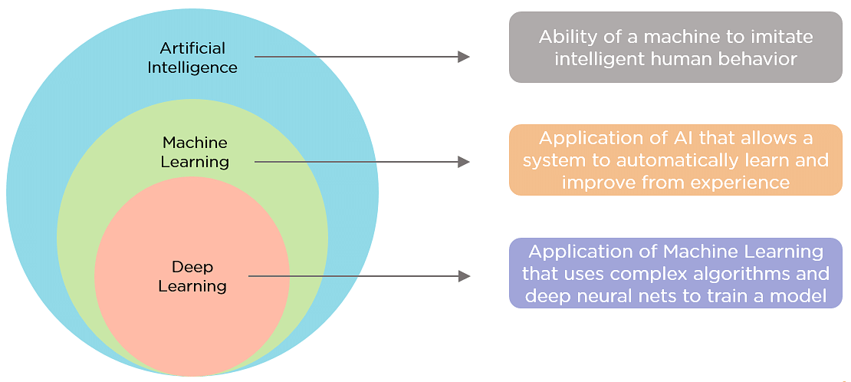

Slide 8
Reactive Machines: capable of responding to external stimuli in real time. Limited Memory: Machines that can store knowledge and use it to learn and train for future tasks. (Machine Learning) Theory of Mind: sense and respond to human emotions. Self-aware: The final stage of AI where machines can not only recognize the emotions of others, but also have a sense of self and a human-level intelligence.

Slide 9
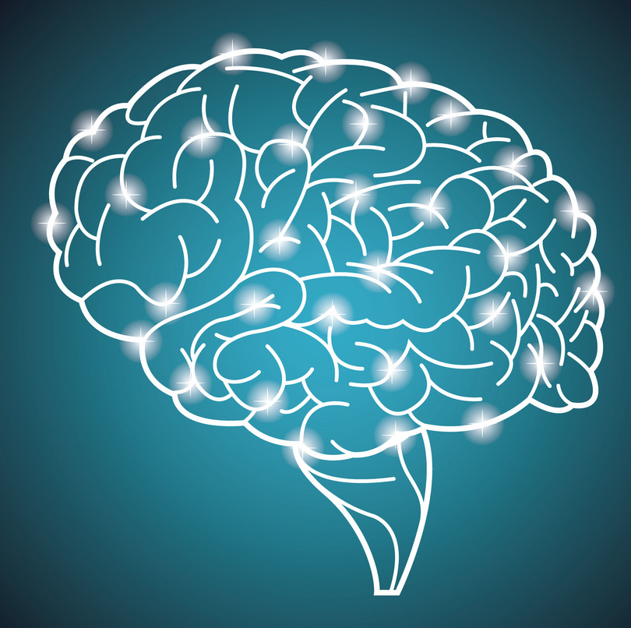
Type of Machine Learning Learn and improve from provided data Motivation from structure of human brain -> often called Neural Network
Playground: https://playground.tensorflow.org/

Slide 10
Steps: 1. Collect Data 2. Clean Data 3. Build Model 4. Fine Tuning (Improve Performance) 5. Train Model 6. Test Model API: TensorFlow vs PyTorch

Slide 11
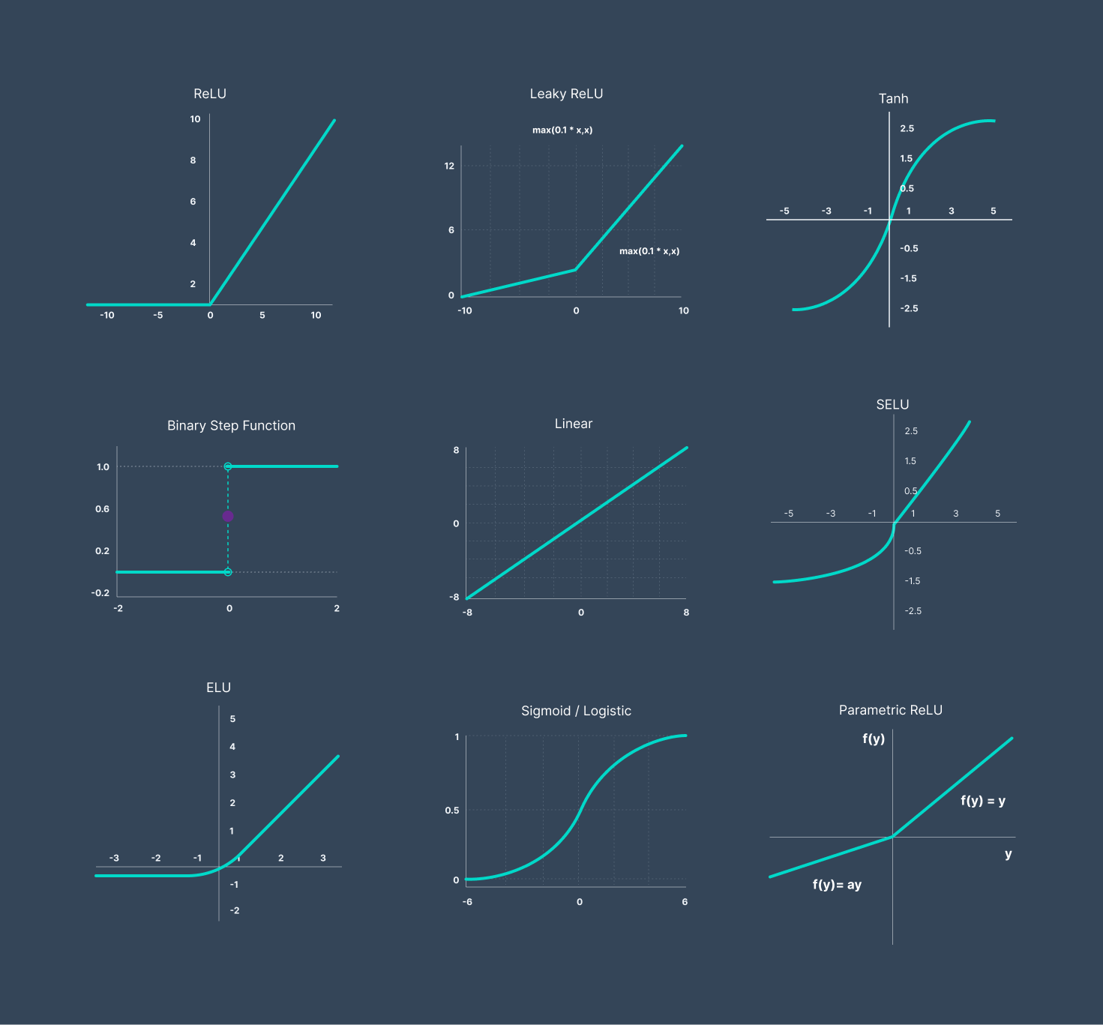

Slide 12
Q&A
Placeholder confidentiality disclosure.

Slide 13
Thank you!
Placeholder confidentiality disclosure.

